Slide 1
CS3210 Lab 3
GPU Parallel Programming in CUDA
Notes:
Prep:
Connect to soctfs
Have sacct_admin.sh
Run monitoring scripts to see the status of the class
Run watch -n 0.5 sudo squeue -a
Run watch -n 0.5 sudo sinfo

Slide 2
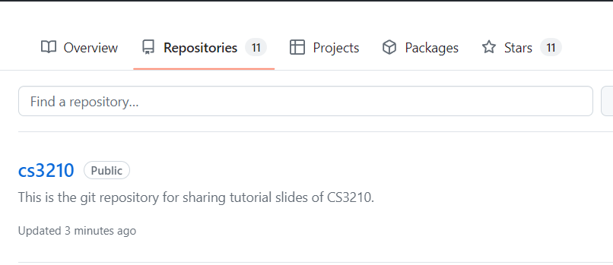
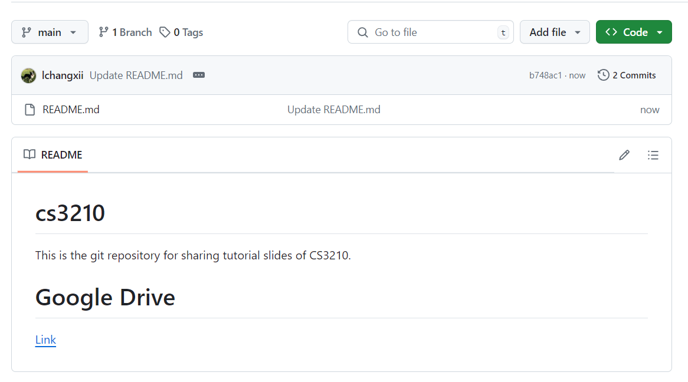
Questions and Slides Sharing
Slides
Github and Google Drive after every session.
https://github.com/lchangxii/cs3210
You can find the Link in the README if preferring Google Drive

Slide 3
Your progress through CS3210 :)
Part 1: OpenMP
Making single-node CPU programs faster
Complex tasks that are relatively less parallelizable (10s of tasks)
Part 2: CUDA
Making single-node GPU-able programs faster
Simpler tasks that are relatively more parallelizable (millions of tasks even)
Part 3: MPI
Making multi-node programs faster
Large, mixed workloads (slow communication between nodes is worth it due to size / parallelizabilty of work)

Slide 4
CUDA is a very deep topic.
We will mainly try to cover the basics - enough!
Highly recommend the CUDA Programming Guide
https://docs.nvidia.com/cuda/cuda-c-programming-guide/index.html

Slide 5
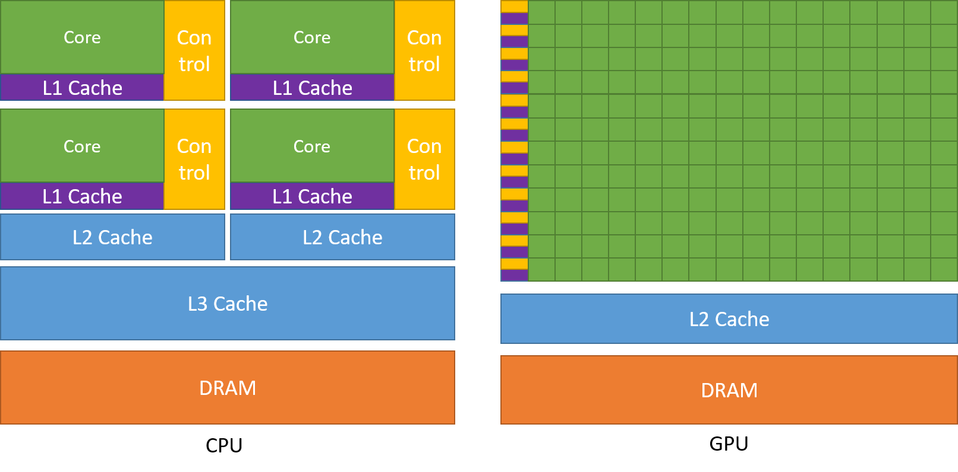
CPU vs GPU: Latency vs Throughput
Complex cores,
low latency
Many simple cores, high throughput

Slide 6


CPU vs GPU:
CPU
GPU

Slide 7
Main point:
To maximize CUDA performance, you must understand GPU hardware

Slide 8
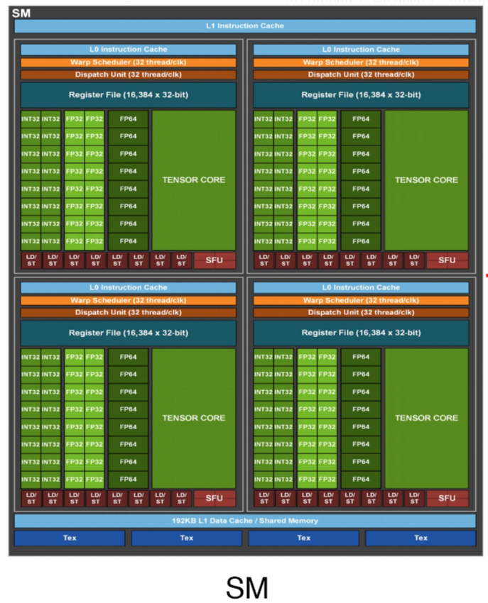
CUDA Physical Structure
GPU: many Streaming Multiprocessors (SMs)
One SM contains many CUDA cores, Tensor Cores
Each SM: runs many “thread block” (one thread block can has many warps)
Each SM: runs many warps (groups of 32 threads) in parallel
Notes:
https://developer.nvidia.com/blog/cuda-refresher-cuda-programming-model/#:~:text=CUDA%20kernels%20are%20subdivided%20into,of%20threads%20(Figure%202).

Slide 9
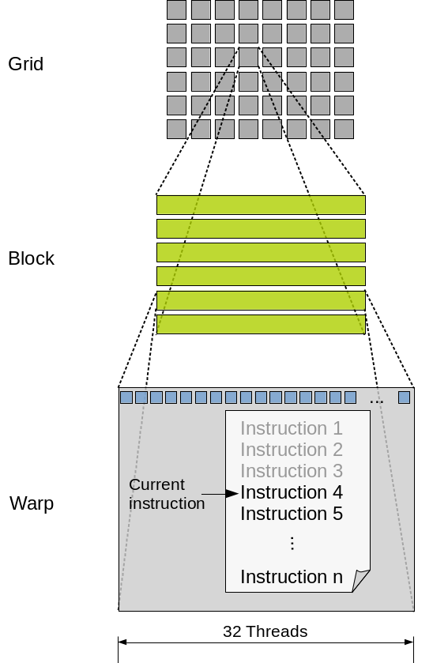
CUDA Logical Hierarchy
A warp executes code on a CUDA core
Specifically, a warp (groups of 32 threads) executes in lockstep in a core (SIMD).
Warps can be organized in blocks
Blocks are organized into a logical grid
Hardware does not care about grids!
optional: H100 introduces Thread Block Cluster
One thread block cluster has multiple blocks
Notes:
https://developer.nvidia.com/blog/cuda-refresher-cuda-programming-model/#:~:text=CUDA%20kernels%20are%20subdivided%20into,of%20threads%20(Figure%202).

Slide 10
Overview of Physical-Logical Connection
CUDA cores
tensor
cores
threads inside one warp must run on the same CUDA core or tensor core at the same time

Slide 11
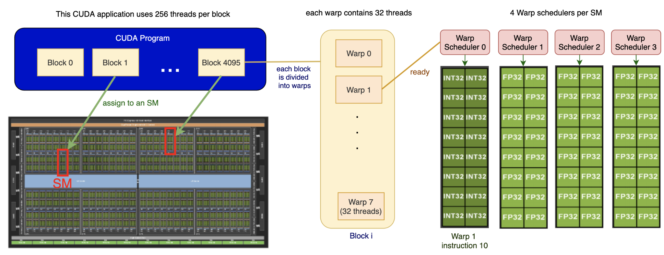
Overview of Physical-Logical Connection
warps in one Block must run on the same SM

Slide 12
Optional : GPC (GPU Processing Clusters)
GPC
Thread Block Cluster must execute on the same GPC (H100 GPU)

Slide 13
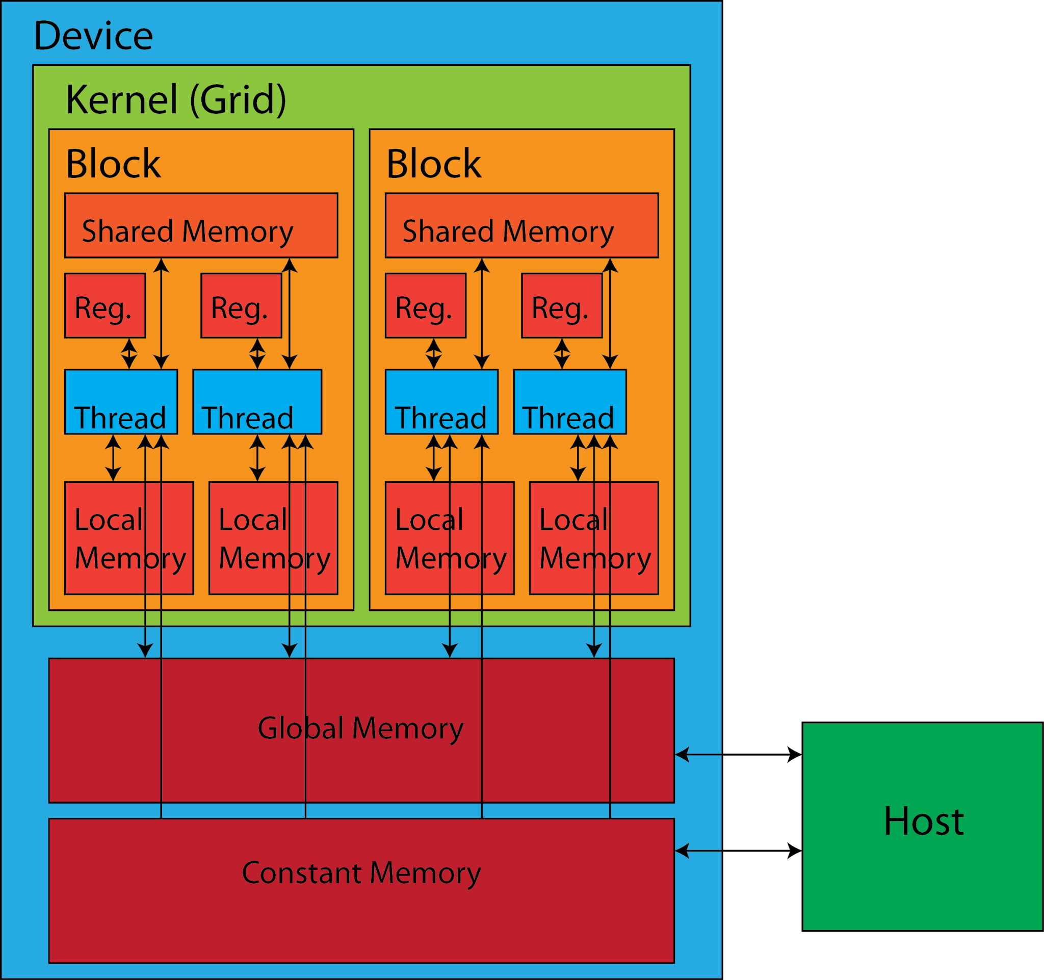
Example optimizations from knowing hardware
Warps are 32 threads, so any block sizes not divisible by 32 have wasted threads (i.e. they run but do no meaningful work)
Keep threads simple and minimize control flow logic (if/else)
Prefer registers > shared > global memory

Slide 14
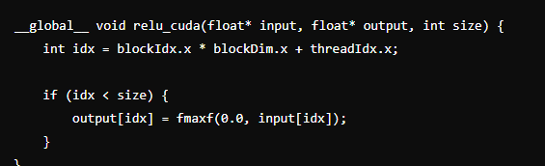
Example optimizations from knowing hardware
Write code in the thread level
Think about the CUDA code in the warp level
memory addresses accessed by threads within the same warp to be consecutive. (Spatial Locality)

Slide 15
Today's Lab

Slide 16

SoC Cluster vs PDC Cluster
xlogin node
xgp GPU nodes
pdc lab
managed by us
SoC Compute Cluster
managed by SoC
They are on separate networks!

Slide 17
Good news!
We have top-tier GPUs for you to play with!
Node Name | Slurm GPU Name | NVIDIA GPU Name | Compute Capability | Memory | Notes
xgpc[0-9] | nv | Tesla V100 | 7.0 | 16GB
xgpd[0-9] | nv | Titan V | 7.0 | 12GB
xgpe[0-11] | nv | Titan RTX | 7.5 | 24GB
xgpf[0-10] | nv | Tesla T4 | 7.5 | 16GB
xgpg[0-9] | a100-40 | A100 40GB | 8.0 | 40GB
xgph[0-9] | a100-80 | A100 80GB | 8.0 | 80GB
xgph[10-19] | a100-40 | A100 80GB | 8.0 | 40GB | Split into 2x 40GB instances
xgpi[0-9] | h100-96 | H100 96GB | 9.0 | 96GB | 2x H100 96GB
xgpi[10-19] | h100-47 | H100 96GB | 9.0 | 47GB | 2x H100 96GB, split into 4x 47GB instances

Slide 18
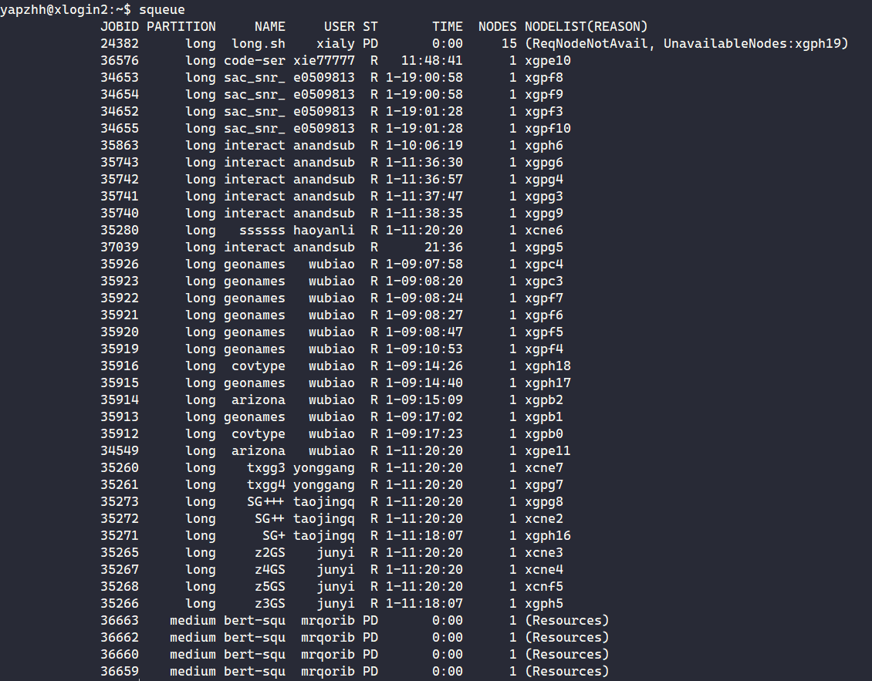
Bad news :(
We have to share with others.
(Currently the cluster is under-utilized, so do let us know if your jobs are not running!)

Slide 19
Login instructions (TLDR)
Ensure you're on FortiClient VPN
ssh <SoC unix username>@xlogin0.comp.nus.edu.sg OR ssh <SoC unix username>@xlogin2.comp.nus.edu.sg (as of now, xlogin1 has issues dispatching slurm jobs)
Test that you can get a GPU via srun --gpus=1 bash -c "hostname; nvidia-smi"

Slide 20
Lab 3 Overview
ex1-4: orientation with xlogin's slurm
ex5: hello world
ex6: calculating thread id
ex7-8: understanding warps [demo]
ex9: compile time __device__(global) variables
ex10: cudaMalloc-ed __device__(global) variables
ex11: unified memory with __managed__ [demo]
ex12: shared memory with __shared__
ex13: Atomic memory operations (atomicAdd, etc)
ex14: explicit synchronization [demo]
ex15: putting it together to optimize a simple program
CUDA is very new to you, we generally don't expect you to complete everything within 2 hours.

Slide 21
Note about CUDA executables
CUDA commands (e.g. nvcc, nsys) is not in $PATH
Cannot just use srun without specifying the full path to the executables i.e. need to specify /usr/local/cuda-12.2/bin/nvcc to compile your code with nvcc
Provided gpu_job.sh script helps you get around that, but you can also use srun manually.

Slide 22
Note about CUDA executables
Not mentioned in our student guide or lab sheet, you can also add this to ~/.bashrc
export PATH="/usr/local/cuda/bin/:$PATH" export LD_LIBRARY_PATH="/usr/local/cuda/lib64:$LD_LIBRARY_PATH"
Now you can just call nvcc without full path!
Tips: source ~/.bashrc (sometimes, you should manually source it)

Slide 23
More life-pro tips from me
Add these lines to ~/.bashrc
export PATH="/usr/local/cuda/bin/:$PATH" export LD_LIBRARY_PATH="/usr/local/cuda/lib64:$LD_LIBRARY_PATH" alias tv100="srun --gpus=1 --constraint=xgpc" alias tvolta="srun --gpus=1 --constraint=xgpd" alias trtx="srun --gpus=1 --constraint=xgpe" alias tt4="srun --gpus=1 --constraint=xgpf" alias a100mig="srun --gpus=a100-40 --constraint=xgph" alias a100a="srun --gpus=a100-40 --constraint=xgpg" alias a100b="srun --gpus=a100-80" alias h100mig="srun --gpus=h100-47" alias h100="srun --gpus=h100-96"

Slide 24
Ex6 hint
https://www.eecs.umich.edu/courses/eecs498-APP/resources/materials/CUDA-Thread-Indexing-Cheatsheet.pdf
(Can be found in your lab sheet)

Slide 25
Ex7: Understanding Warp Divergence & Independent Thread Scheduling

Slide 26
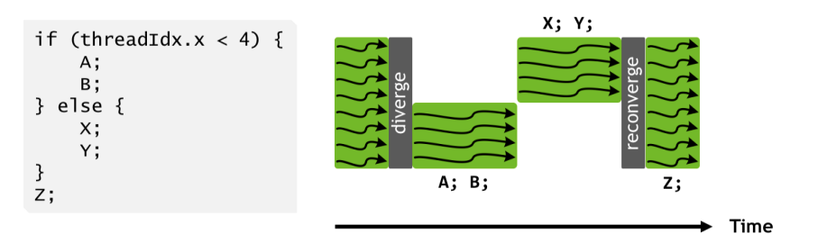
Old: NVIDIA Pascal (<= CC 6.x)
Threads in the same warp may diverge under different control flow - this is still true today
Pascal and earlier: entire divergent region must converge first

Slide 27
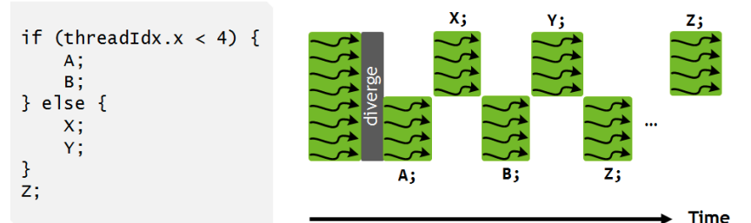
New: NVIDIA Volta (>= CC 7.x)
Independent thread scheduling (ITS)
Different statements in the divergent branches can interleave

Slide 28
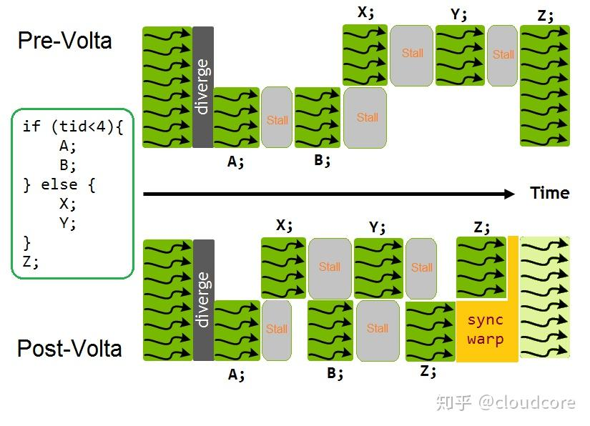

Slide 29
Demonstrating issues with divergence
vim its_share.cu
"nvcc -o its_s_70 --std=c++17 -arch sm_70 -O0 -Xptxas -O0 its_share.cu; ./its_s_70"
"nvcc -o its_s_50 --std=c++17 -arch sm_50 -O0 -Xptxas -O0 its_share.cu; ./its_s_50"
Don't mind the long commands
Notes:
srun --constraint xgpb --gres=gpu:1 bash -c "/usr/local/cuda-12.2/bin/nvcc -o its_s_50 --std=c++17 -arch sm_50 -O0 -Xptxas -O0 its_share.cu; ./its_s_50"

Slide 30
Observations
Not much difference in runtime between different CC versions!
This is just because our demo program here is very simple.
For more complex programs with many memory operations, the interleaving of control flows will perform slightly better.
Control flow divergence within warps can cause slowdowns.
Top reason why some students can't meet our performance criteria for asgn 2 last year.
Minimize the number of if-statements in your device code!
Divergence between warps does not have an issue.
Notes:
source: trust me bro i marked assignment 2 last year

Slide 31
Ex11: Unified Memory

Slide 32
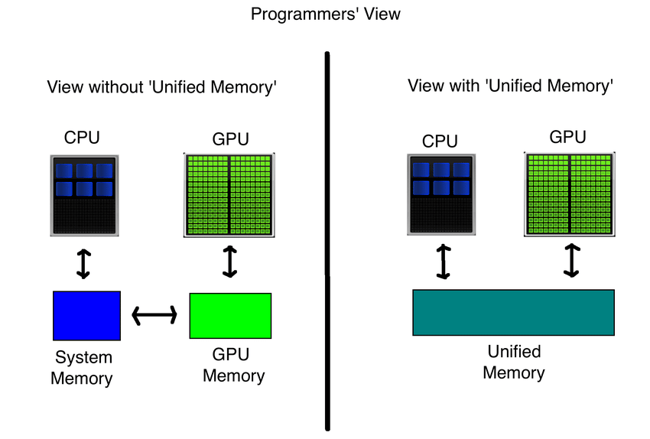
Unified Memory

Slide 33
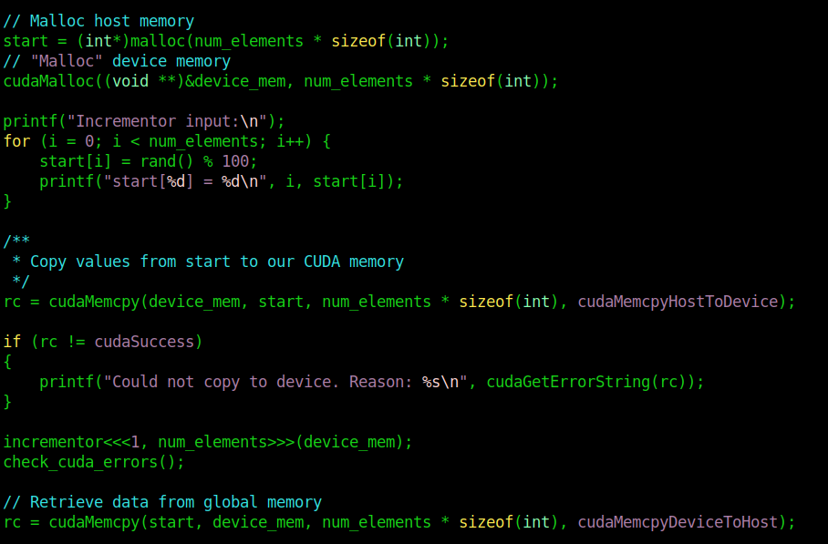
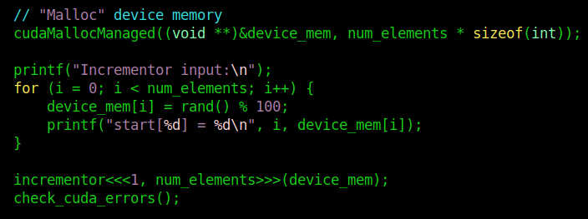
Unified Memory
Normal
Unified

Slide 34
Why not use unified memory always?
Unified is a tiny bit slower! But much easier to program.
You can give “hints” to CUDA to make unified almost as fast as normal, but generally non-unified memory is faster

Slide 35
Performance Profiling

Slide 36
Performance Profiling
The greatest sin of optimization: optimization without profiling
How to profile CUDA applications?
nvprof / NVIDIA Visual Profiler (deprecated past CC 7.5!)
Now: ncu (NVIDIA Compute CLI, for kernels) and nsys (NVIDIA NSight Compute, general profiler)
Read: https://gpuhackshef.readthedocs.io/en/latest/tools/nvidia-profiling-tools.html
Examples
nsys profile -o sum_ans_short ./sum_ans_short
nsys analyze sum_ans_short.nsys-rep
ncu ./sum_ans_short

Slide 37

link

